Slide 1
School pack: International Day of Play
Suggested length
45-60 minutes (or however much time you have!)
Suggested age group
7+
Play is essential and it is a right for every child. That’s why global leaders came together this year to make International Day of Play on 11 June: A day dedicated to the power of play.
Summary
Key Vocabulary
Right, Play, Barrier, Prevent
Teachers: Check the notes section for speaking points and ideas
(click View > Notes)
I can describe what a right is.
I can explain why play is important.
I can explain how I can use my voice to make a difference.
Children statements

Slide 2
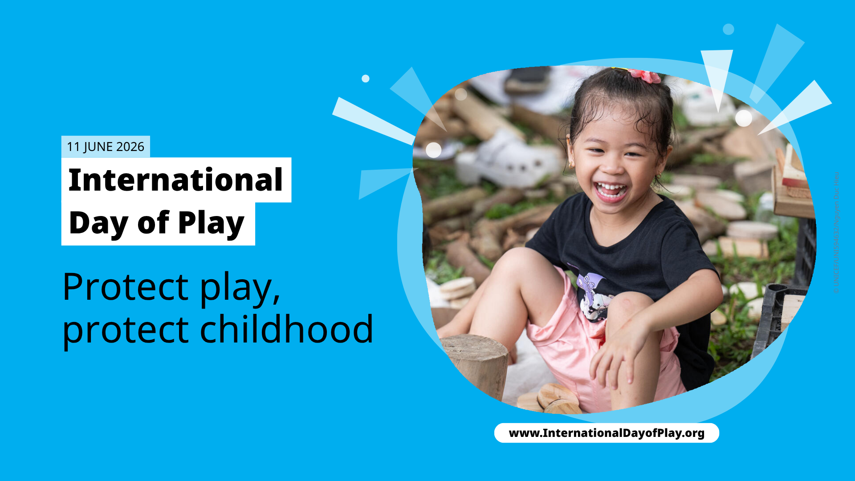

Slide 3
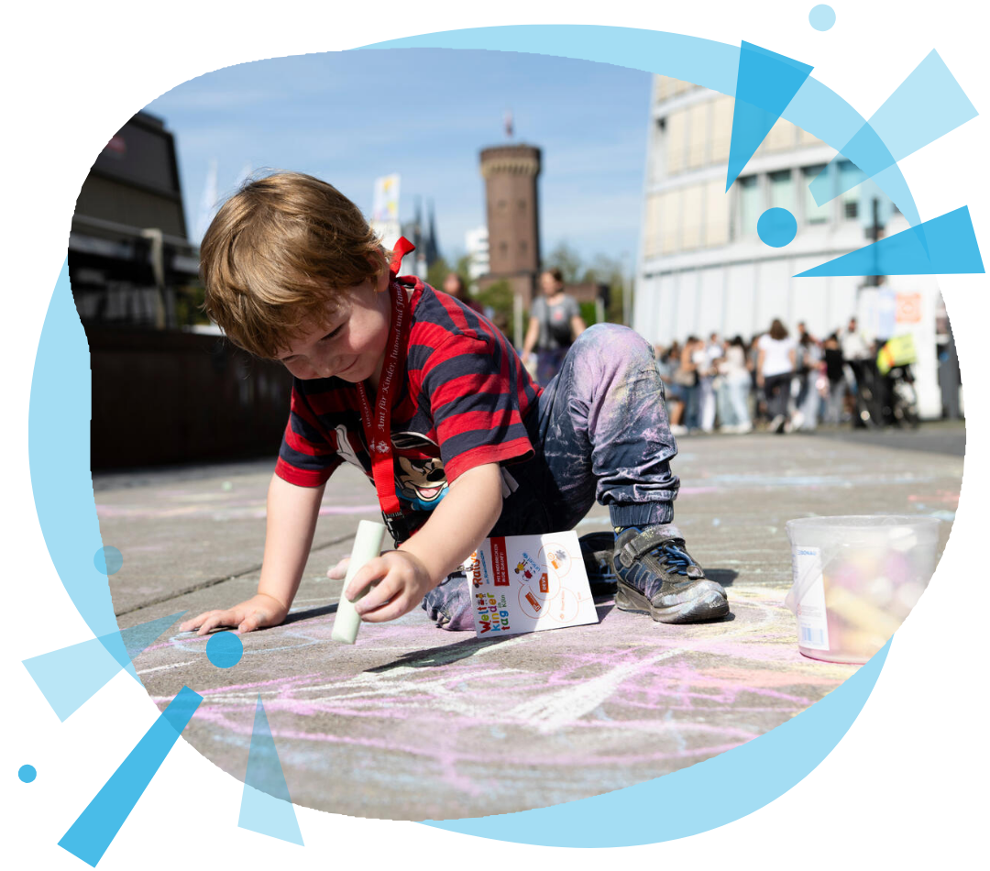
I can describe what a right is.
I can explain why play is important.
I can explain how I can use my voice
to make a difference.
Notes:
Introduce the children to the topic for activity and the learning targets.
This activity is about children’s right to play. At the end of this activity, children will be able to explain what a right is, why it is important to play, and how they can raise their voice to make a difference.

Slide 4
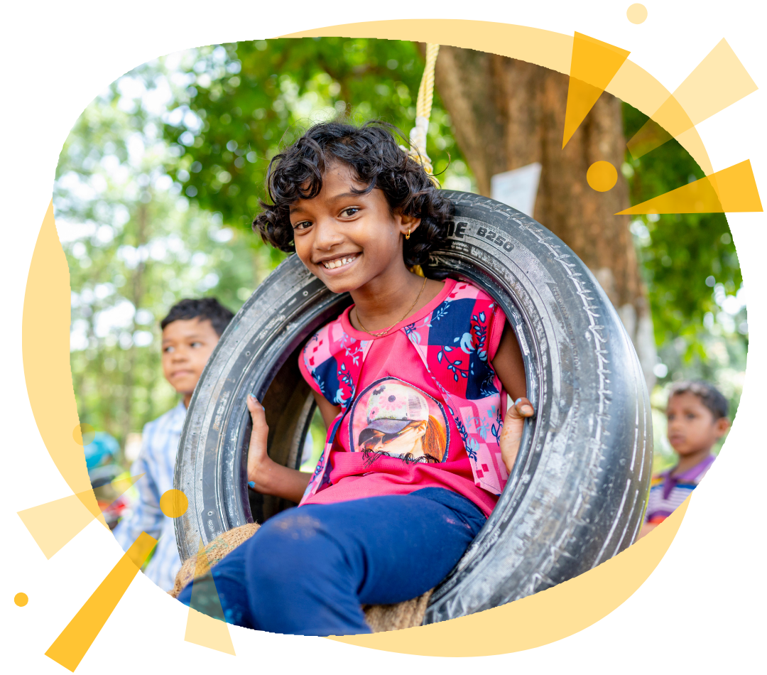
Talk about it
What does it mean to play?
Notes:
Engage children with questions like:
What do you think of when you hear the word “play?”
What does it mean to play if you’re a child?
What does it mean to play if you’re an adult?
Who else plays?
Tell children that they’re going to learn all about play by playing!

Slide 5
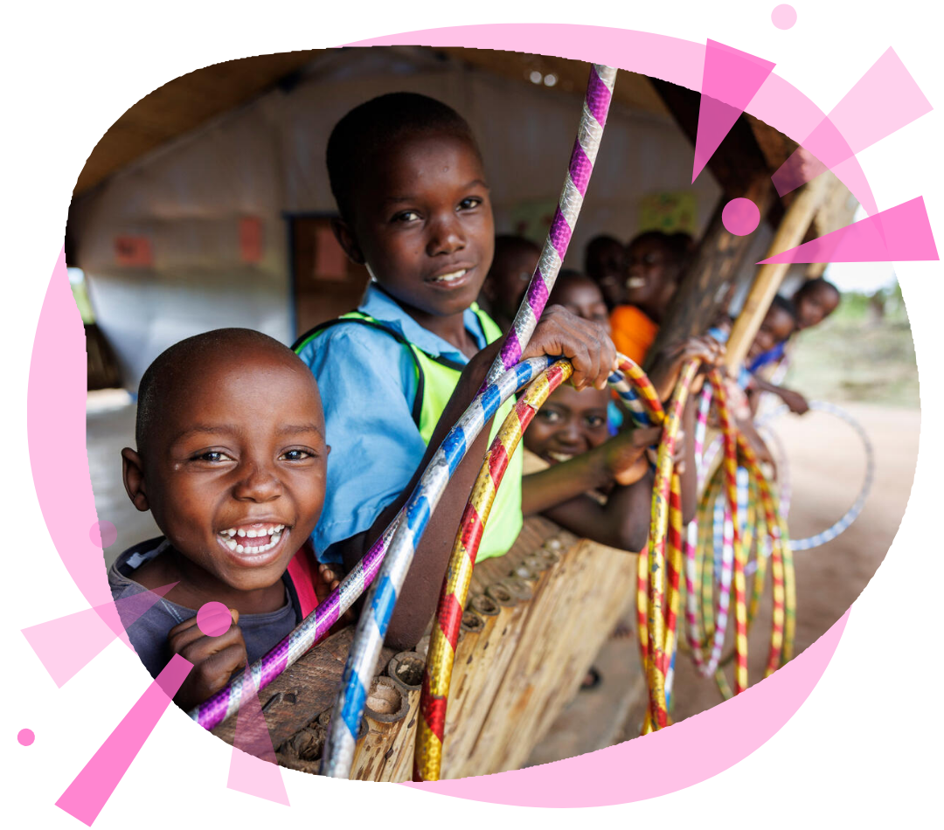
Did you know?
You have a right to play.
Notes:
Depending on children’s pre-existing knowledge, you may need to support them in understanding what “rights” are.
A student friendly definition of “rights” is promises and rules that everyone has in the world. For example: It doesn’t matter where you are in the world; you have the right to play.
Every person in the world has rights that keep them safe and happy.
It doesn’t matter where they are from, what they look like, or what they believe in—everyone has these rights.
These include the right to live freely, to be treated kindly, to say what they think, to go to school, and to work when they grow up.
No one is allowed to take these rights away from anyone!
The UN defines “rights” as: “…inherent to all human beings, regardless of race, sex, nationality, ethnicity, language, religion, or any other status. Human rights include the right to life and liberty, freedom from slavery and torture, freedom of opinion and expression, the right to work and education, and many more. Everyone is entitled to these rights, without discrimination.”
Ask children to think about the idea of “right to play.” What do they think this means? Do they use this right sometimes? Always? Never?

Slide 6

What is preventing children from playing?
Notes:
Tell children that even though they have the right to play, there are barriers or things that can prevent children from playing.
[To consider: The words barrier and prevent may need defining here for the students
Barrier: Something that blocks the way or blocks you from doing something. For example, the sea wall is a barrier that stops the seawater from coming into the town.
Prevent: Something that stops something from happening. For example, brushing your teeth prevents cavities]
OK, back to the main event…
Ask the big question: Do you think children are playing less in some parts of the world? Why do you think this is? What is preventing them from playing?
Encourage children to think broadly. Depending on children’s knowledge, support their understanding by providing some of the possible answers:
More children are living in cities where there is less outdoor, green space
There aren’t many safe spaces to play
There is less play in a lot of schools around the world
Learning in school for many children is all about memorizing facts
Parents and caregivers have less time to play
Children are not playing outdoors in nature as much
Cities and towns are overcrowded
Remind children that play doesn't have to be a separate activity. Anything can be play: A playful way to do math at school or a new game to put away rolled up socks! Their walk home from school could involve splashing in puddles! Play can be PART of their everyday!

Slide 7
Time to think…
How can we make the world more playful?
Notes:
Tell children it is time to use their imagination to solve their challenge. Their challenge is: How can they make the world more playful? Children will solve this challenge by creating an artifact, object, or other visual representation that describes their idea.
Start by encouraging children to think about what their idea is and then they’ll work to create something that represents their idea. Children will think and plan and then do!
Encourage children to think about:
Boring tasks that could be made more fun
How play makes you feel
Why play important to you
What play looks like to you
The sky is the limit. Children can think of whatever wild or fun ideas—anything is possible. All ideas are welcomed and encouraged.
Children should work in groups of 2-4* to brainstorm and plan their idea. Children can think through their ideas by talking with their peers or by writing down their ideas and then sharing them with their group. There is no right or wrong way to think through your ideas!
*If group work is not a preferred working style, that is totally okay! This activity can also be done individually.

Slide 8
[Optional slide: Ideas to help children play]
Theo
Emma
Hannah
Hannah
Notes:
If children need additional help to think through their ideas, provide them with the following examples to help spark ideas.
How can children help these children to play:
HANNAH doesn't know how to play. She doesn't think she's really good at anything. What can you create to help Hannah?
THEO lives in a city where there are no safe spaces to play. He can play inside his apartment, but it is crowded and there isn’t enough room. What can you do to help him play?
EMMA doesn’t have enough time to play. She goes to school and then comes home to help her family with chores. What can you build to help Emma play more?

Slide 9
Time to create…
Something that makes the world more playful
Notes:
Children will explore the challenge: How can they help make the world more playful?
Remind them to think about which barrier they are helping remove? Is it something to do with time to play, space to play or even ways to play?
Children can use any materials on hand (e.g. paper, recycled material, pens, paint, etc.)
The suggestion is to give 25 minutes time to create, but times can be shorter or longer.

Slide 10
Time’s up!
Notes:
Bring this up once the “time to create” is up.

Slide 11
Time to share!
Notes:
Encourage children to share their work and solution. Be sure ask to ask children what barrier (what prevents someone from doing something) to play they were trying to solve and how their solution fixes it.
Who would you like to share this with to encourage them to play more?

Slide 12
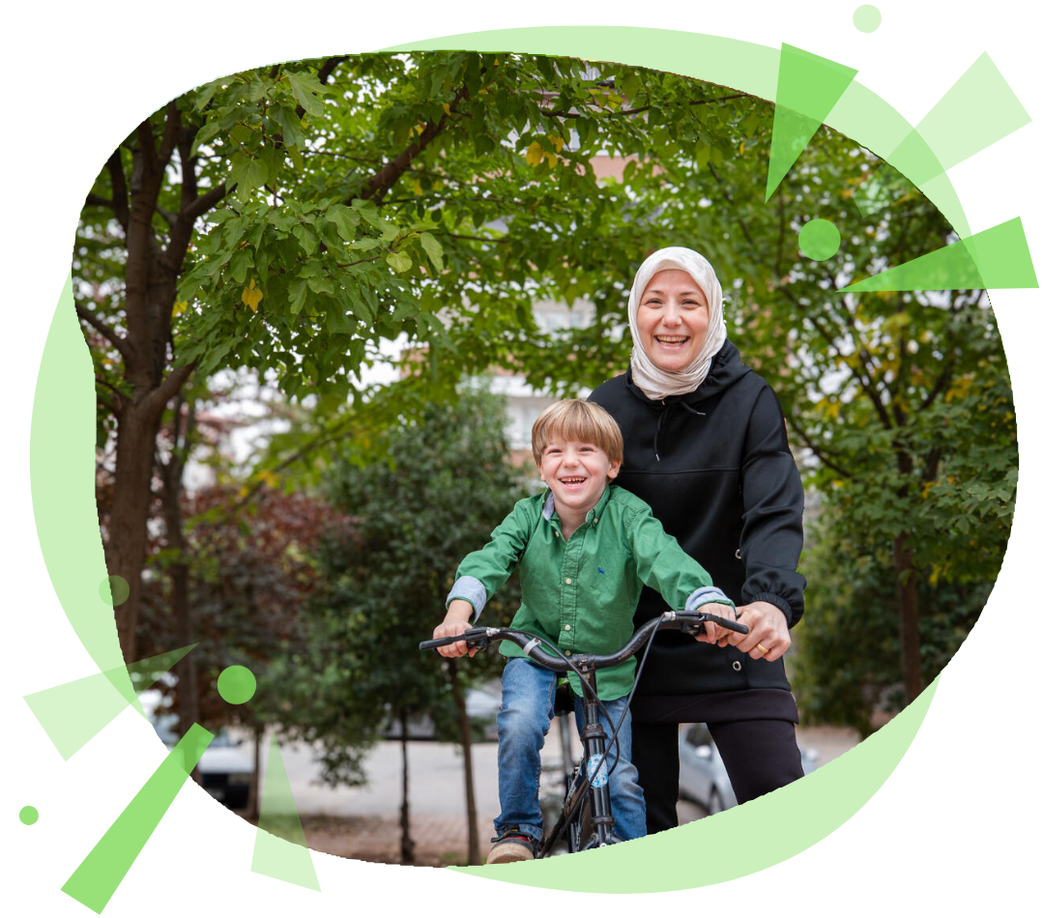
What’s next?
Who would you like
to encourage to play?
Notes:
Ask children for ways that they can get more people to understand the importance of play. Ask questions like:
What are some tools they could use to help spread the message?
What is important for adults to know about play? How can you tell them?
How would you explain to an adult what you know about play?
Remind children that their ideas are powerful and that they can help make positive changes in the world.

Slide 13
Well done everyone!
www.InternationalDayofPlay.org
#InternationalDayofPlay
Notes:
That’s it for this session! Well done everyone and thanks for participating in International Day of Play!

