Slide 1

The EU Child Guarantee Conference
Effective and Inclusive Policies and Programs for Children Aligned with
EU Standards
26 September 2024
Notes:
A big thank you to the authorities of Moldova and partners from Unicef for organising the event.
I am happy to take part in the meeting, even if it is only online to share our experiences on our work related to safeguarding and protection of the interests of children who are most at need and to tell you more about the European Child Guarantee.
It is really great to see that Moldova is embarking on the important journey of providing children who are most at need with what they require to grow happily in health and safety.
As we have learnt on the way, lifting children out of poverty is not only our moral duty and obligation but it also calculates, it is an investment for the future which will bring returns!
But first things first, to give you a better understanding of what is the European Child Guarantee, let me first explain the context in which we operate in the EU.

Slide 2
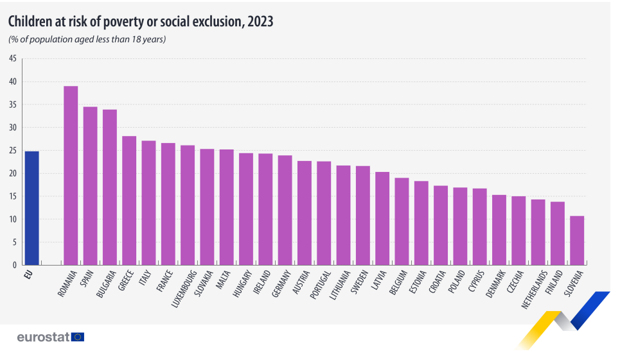
Notes:
Almost 20 million children across the EU are still at risk of poverty or social exclusion last year. In 2023, it was 24.8% of children compared with 20.6% of adults.
It is a huge number in itself, one in four children in the EU lives in a low-income household, has parents who work much below their working time potential, or is exposed to severe material and social deprivation. Those predicaments mean not only suffering in childhood – which is unacceptable – but also form a part of a vicious circle of poverty that is transmitted between generations.
The earlier we address this challenge, the greater our chances of success. This is why we need to invest in early childhood development, aiming to eliminate – or at least minimise – the impact of household’s poverty on health of its children, and to include those children in quality education as early in their lives as possible. We know for a fact that attending crèche and kindergarten increases lifelong educational attainment of a person. This increase is most significant for people stemming from families with low socio-economic status.

Slide 3

Policy framework
Commission Recommendation on Investing in Children: Breaking the cycle of disadvantage (2013)
Broad framework for developing policies to promote social inclusion and well-being of children, especially in vulnerable situations. The Guarantee develops its second strand related to access to affordable, quality services.
European Pillar of Social Rights (2017) and its Action Plan (2021)
Deliverable of the Pillar, part of a broader framework for combatting poverty or social exclusion.
Contributes to achieving poverty reduction targets – lift 15 million people out of risk of poverty or social exclusion (AROPE), of this at least 5 million should be children.
EU Strategy on the Rights of the Child (2021)
Adopted by the Commission together with the Guarantee.
Pools initiatives on children’s rights under one coherent policy framework.
Includes thematic area 2: Socio-economic inclusion, health and education.
Notes:
For more than a decade, EU has been supporting Member States to break the circle of disadvantage. The 2013 Commission recommendation on investing in children called to develop integrated strategies, based on three key pillars: access to adequate resources, access to affordable quality services, and ensuring children’s right to participate.
Moreover, the European Pillar of Social Rights Action Plan has set an EU-wide target to reduce the number of people at risk of poverty or social exclusion by 15 million before 2030, among whom at least 5 million should be children. This can be done mostly by improving labour market prospects of their parents, but also through child-contingent cash support. According to a recent study by the Joint Research Centre, the resulting reduction of child poverty might be as large as 16 percentage points. Most Member States have set national targets contributing to the overall poverty reduction target, which we closely monitor in a yearly exercise under the European Semester.
There is also the EU Strategy on the Rights of the Child adopted in 2021 simultaneously with the European Child Guarantee, which is a comprehensive EU policy framework to ensure the protection of rights of all children, and secure access to basic services for vulnerable children. It encompasses actions to better protect all children, to help them fulfil their rights and to place them right at the centre of EU policy making.

Slide 4

European
Child
Guarantee
Social
exclusion
Affects school performance
and health
BREAK
THE CYCLE
Drop out
of school
Aims to prevent and combat social exclusion by guaranteeing access of children in need to a set of key services, thereby also contributing to upholding the rights of the child by combatting child poverty and fostering equal opportunities.
Poverty
Long-term unemployed
Notes:
Social exclusion is a complex and multidimensional phenomenon. Its key drivers are insufficient resources and poverty, but also lack of equal access to goods and services due to various forms of disadvantage, preventing full participation in the society.
Breaking the intergenerational cycles of disadvantage starts with investment to reduce the gap in access to key services between children in need and their better-off peers.

Slide 5
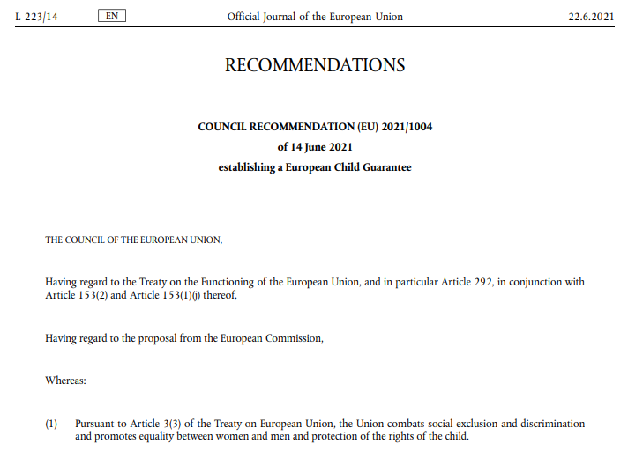
Council recommendation establishing European Child Guarantee
Adopted unanimously by the Council (Member States) following a proposal of the Commission
Notes:
In this context, Council recommendation establishing European Child Guarantee was adopted in 2021 in record time of three months! The Member States approved it unanimously.
The objective of this flagship EU instrument is to prevent and combat social exclusion of children by guaranteeing by 2030 access of children in need to early childhood education and care, education (including school-based activities), healthcare, nutrition, and housing.
While most children in the EU already have access to these services, inclusive and universal access is vital for ensuring equal opportunities for all children, and in particular those who experience social exclusion either due to poverty or other forms of disadvantage.

Slide 6
Measuring child poverty
Children are at risk of poverty or social exclusion (AROPE) when they are either:
at risk of poverty (parents’ income below the at-risk-of-poverty threshold, set at 60 % of the national median income with specific weighting for children),
severely materially and socially deprived (enforced lack of at least 7 out of 13 necessary items – e.g. ability to keep home adequately warm…)
or living in a household with a very low work intensity (working age members of the household working for a time equal to or less than 20% of their total work-time potential during the previous year)
Notes:
The European Child Guarantee targets ‘children in need’, which refers primarily to children at risk of poverty or social exclusion.
What do we mean by that? When we speak about children being at risk of poverty or social exclusion, we refer to their households (in common speech: families) being exposed to one of the following three adversities:
Risk of poverty (abbreviated as AROP, for at-risk-of-poverty): household income is below 60 % of the national median income, with specific weighting for the size of the household,
Severe material and social deprivation (enforced lack of at least 7 out of 13 necessary items – e.g. ability to keep home adequately warm, etc)
Very low work intensity (working age members of the household working for a time equal to or less than 20% of their total work-time potential during the previous year)
In other words, reducing child poverty requires helping their household have access to more resources, and these more resources are of course of use to address the cost of rearing children.

Slide 7
Target group: children in need
Children under the age 18 years who are at risk of poverty or social exclusion.
The recommendation asks the Member States to identify children in need and take into account specific disadvantages experienced by:
homeless children or those experiencing severe material deprivation;
children with disabilities;
children with mental health issues;
children with a migrant background or a minority ethnic origin (particularly Roma);
children being in alternative (especially institutional) care;
children in precarious family situations (e.g. single-parent household, imprisoned parent or parent with a disability, mental or long-term illness, or addiction; teenage mother; exposure to violence; left-behind children of EU citizens).
Notes:
Alongside poverty, other forms of disadvantage create barriers for inclusion and participation of children in the society. Thus, the Recommendation on European Child Guarantee asks Member States to identify children in need taking into account the specific needs, in particular of
homeless children or children experiencing severe housing deprivation;
children with disabilities;
children with a migrant background;
children with a minority racial or ethnic background (particularly Roma);
children in alternative (especially institutional) care; and
children in precarious family situations.
The focus on children in need is meant to prevent them from remaining at risk of poverty or social exclusion as adults.

Slide 8

…free and effective access to:
Services covered
early childhood education
and care
education and school-based activities
at least
one healthy
meal each
school day
healthcare
Member States should guarantee
for children in need…
…effective access to:
healthy nutrition
adequate housing
Notes:
In line with the European Child Guarantee, EU Member States should guarantee effective access to a set of key services to children in need, namely
free early childhood education and care
free education (including school-based activities and at least one healthy meal each school day)
free healthcare
healthy nutrition, and
adequate housing

Slide 9
Type of access to services
Effective access - services are readily available, affordable, accessible, of good quality, provided in a timely manner and where the potential users are aware of their existence, as well as of entitlements to use them;
Effective and free access - services are readily available, accessible, of good quality, provided in a timely manner, where the potential users are aware of their existence, as well as of entitlements to use them. They are provided free of charge, either by organising and providing such services or by adequate benefits to cover the costs or the charges of the services, or in such a way that financial circumstances will not pose an obstacle to equal access.
Notes:
Effective access - services are readily available, affordable, accessible, of good quality, provided in a timely manner and where the potential users are aware of their existence, as well as of entitlements to use them;
Effective and free access - services are readily available, accessible, of good quality, provided in a timely manner, where the potential users are aware of their existence, as well as of entitlements to use them.

Slide 10
Free and effective access to early childhood education and care
Share of children (<3 years) attending formal childcare for at least 1 hour per week (2022)
17
is the average percentage points gap between the participation of children AROPE and not AROPE in formal childcare in the EU
EU
Source: Eurostat
Notes:
When it comes to ECEC, there is a clear gap of attendance between the overall population of children and children at risk of poverty – while the latter would actually benefit the most from attending.
Multiple studies documented the positive impact of ECEC on children’s educational outcomes and this would also allow their parents to work, and better reconcile their family aspirations with work.
The goal of the Guarantee is to close this participation gap for ECEC and all the other services.

Slide 11


Free and effective access
Recommendations
early childhood education
and care
education and school-based activities
address financial and non-financial barriers to participation;
provide educational materials, text books, school uniforms, digital services and IT equipment for distance learning;
provide school transport;
ensure at least one healthy meal each school day;
ensure access to school-based activities, including school trips;
prevent and reduce early school leaving;
provide learning support for pupils with learning difficulties;
adapt facilities and educational materials to children with disabilities;
support inclusive education and avoiding segregated classes; give priority or early access for children in need;
develop cooperation framework for schools, communities, social services and social economy actors to provide inclusive education, after school care, opportunities to participate in sport, leisure and cultural activities, and to invest in schools as centers of inclusion.
Notes:
So the Child Guarantee Recommendation provides a set of tasks for the Member States in each of the areas.
In the area of Free and effective access to Early Childhood education and care, it asks the Member States to:
address financial and non-financial barriers to participation;
provide educational materials, text books, school uniforms, digital services and IT equipment for distance learning;
provide school transport;
ensure at least one healthy meal each school day;
ensure access to school-based activities, including school trips;
prevent and reduce early school leaving;
provide learning support for pupils with learning difficulties;
adapt facilities and educational materials so that children with disabilities can use them;
support inclusive education and avoiding segregated classes; give priority or early access for children in need.

Slide 12
Effective and free access to education and school-based activities
Share of children (<16) AROPE and not AROPE suffering from the enforced lack of access to regular leisure activities in 2021
Source: Eurostat
Notes:
On the slide you can see Share of children (<16) AROPE and not AROPE suffering from the enforced lack of access to regular leisure activities in 2021.

Slide 13
Effective and free access to at least one healthy meal per school day/effective access to healthy nutrition
Share of children (<16) AROPE and not AROPE suffering from the enforced lack of access to fresh fruits and vegetables once a day in 2021
Source: Eurostat
Notes:
The slide provides data on the Share of children (<16) AROPE and not AROPE suffering from the enforced lack of access to fresh fruits and vegetables once a day in 2021

Slide 14


Recommendations
At least one healthy meal each school day
Healthy nutrition
Free and effective access
Effective access
support access to healthy meals also outside of school days, in particular during school closures;
ensure that nutrition standards in ECEC and schools address dietary needs;
limit advertising and restrict the availability of unhealthy foods;
educate on healthy nutrition.
Notes:
The recommendation asks the Member States to look at the following aspects in the area of at least one healthy meal each day and healthy nutrition for children in need:
support access to healthy meals also outside of school days, in particular during school closures;
ensure that nutrition standards in ECEC and schools address dietary needs;
limit advertising and restrict the availability of unhealthy foods;
educate on healthy nutrition.

Slide 15
Effective and free access to healthcare
Share of children (<16) AROPE and not AROPE with unmet needs for medical examination or treatment in 2021
Note: data unreliable for DE and IE
Source: Eurostat
Notes:
The slide provides data on Share of children (<16) AROPE and not AROPE with unmet needs for medical examination or treatment in 2021.

Slide 16

Recommendations
Healthcare
Free and effective access
ensure access to medical examinations, screening programmes and vaccinations, to medicines and treatments and to timely follow-up;
provide rehabilitation and habilitation services for children with disabilities;
implement health promotion and disease prevention programmes targeting children in need, their families and professional working with children.
Notes:
The Child Guarantee Recommendation continues to indicate the areas for improvement, this time in the area of healthcare, including through ensuring to children in need of access to medical examinations, screening programmes and vaccinations, to medicines and treatments or providing rehabilitation and habilitation services for children with disabilities.

Slide 17
Effective access to adequate housing
Share of children AROPE and not AROPE living in a household unable to keep home adequately warm in 2022
Source: Eurostat
Notes:
The slide provides data on Share of children AROPE and not AROPE living in a household unable to keep home adequately warm in 2022.

Slide 18

Recommendations
Adequate housing
Effective access
ensure homeless children and their families receive accommodation in emergency shelters or in permanent housing;
assess and revise housing policies/benefits;
provide priority access to social housing;
take into account the best interests of the child as well as the child’s overall situation and individual needs when placing children into institutional or foster care; ensure transition from institutional or foster care to quality community or family based care; and support their independent living and social integration.
Notes:
Finally, the Recommendation focuses on a crucial issue, one of the most problematic in most Member States: adequate housing.
It asks the Member States to ensure homeless children and their families receive accommodation in emergency shelters or in permanent housing; to assess and revise housing policies/benefits; to provide priority access to social housing.
It also highlights the situation of children in alternative care, that is it asks to take into account the best interests of the child as well as the child’s overall situation and individual needs when placing them into institutional or foster care and also to ensure their transition from institutional or foster care to quality community or family based care; and support their independent living and social integration.

Slide 19
Governance / Tasks for the Member States
nominate a national Child Guarantee Coordinator;
national action plans, incl. targets, corresponding measures (national and local) and monitoring & evaluation arrangements in the period until 2030 – all 27 plans received;
involve relevant stakeholders from national, regional and local level, including children in drafting, implementing, monitoring and evaluating the national action plans;
provide adequate resources to fight child poverty and social exclusion;
develop effective outreach measures towards children in need and their families;
biannual reporting to the Commission on implementation of measures –
1st round by March 2024
Notes:
As you can see Child Guarantee is quite ambitious and imposes on the governments a number of demanding tasks.
At the same time what needs to be highlighted is that a Recommendation is a non-binding document. It is not a regulation directly applicable in the national frameworks or a directive which needs to be implemented. It is soft law, which depends on the political will of the ruling governments. How do we work with that?
The Recommendation put in place a number of tools. It asked the MS to:
nominate a national Child Guarantee Coordinator – which they all did;
prepare national action plans, incl. targets, corresponding measures (national and local) and monitoring & evaluation arrangements in the period until 2030 – which they all did;
involve relevant stakeholders from national, regional and local level, including children in drafting, implementing, monitoring and evaluating the national action plans – which a lot of them did;
budget adequate resources to fight child poverty and social exclusion, which they did also with the support of EU funding, in particular the ESF+ (I will still mention that in a while);
develop effective outreach measures towards children in need and their families – crucial if we want to reach the unreached.
report to the Commission biennually on implementation of measures – 1st round by March 2024, we are still receiving the reports.

Slide 20
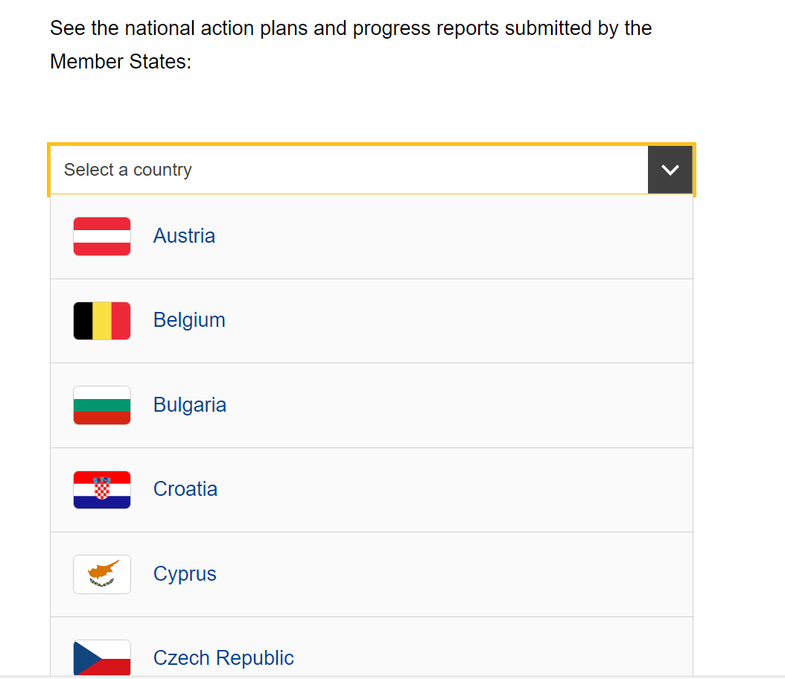
Screen-shot of our website with action plans (plus as speaking point behind it – state of play with progress reports)
Notes:
Here is a snapshot from our website where all the action plans and biennial progress reports can be found.

Slide 21
Examples of national measures
Cyprus | Extension of free compulsory pre-school education for all children aged 4
Netherlands | Free school trips and activities for all children
Luxembourg | Free school meals for all pupils
Notes:
There are a number of tangible results coming from MS as a result of implementation of the Child Guarantee. Just to name a few:
Cyprus: The CY authorities approved the gradual expansion of free compulsory pre-primary education from the age of four from the school year 2024-2025, which will be completed in the school year 2031-2032. Approximately 22,500 children will benefit from this project, which will be funded from bot EU and national resources. Besides allowing the children to go to pre-school for free, new jobs will be created and funding will go to upgrade and expansion of public kindergartens.
NL: Schools are required to allow all children to take part in all activities they organise, including tutoring and school trips, regardless of whether parents have paid their contribution.
LU: Starting from the 2022 school year, all children benefit from free meals during the 36 weeks of school.

Slide 22
European Social Fund Plus is European Union’s main instrument for investments in people.
EUR 142 billion (of which EUR 95 billion is the Union contribution) for the 2021-2027 programming period for employment, social, education and skills policies, including structural reforms in these areas.
ESF+
EU Funding
At least 5% of the ESF+ allocation for measures tackling child poverty in MS where child poverty or social exclusion above EU average; remaining MS should allocate an appropriate amount..
Combating child poverty has been defined as a specific objective in programmes of 23 Member States, totalling EUR 6.1 billion of EU financing (highest amounts of EUR 1.1 billion for IT and EUR 1 billion for PL), or EUR 8.9 billion with national contributions.
Other possible EU funds: European Regional Development Fund and Technical Support Instrument.
Notes:
As you can imagine financing of the different measures is a vital part of the Child Guarantee.
Member States are using their own resources combined with EU funds. There are a couple of possibilities there, however the most prominent one is the European Social Fund Plus (ESF+).
The ESF+ is the European Union’s main instrument for investments in people. With a total budget of EUR 142 billion (of which EUR 95 billion is the Union contribution) for the 2021-2027 programming period, the ESF+ provides an important contribution to the EU’s employment, social, education and skills policies, including structural reforms in these areas.
In fact, according the ESF+ regulation, all Member States should allocate an appropriate amount of their resources of the ESF+ strand under shared management for the implementation of the Child Guarantee and combatting child poverty.
For those Member States that had an average rate of children AROPE above the EU average for the period between 2017 and 2019, the appropriate amount is at least 5% of their ESF+ resources.
According to our calculations, MS have programmed actions combatting child poverty with a total budget of EUR 8,9 billion (EU part: EUR 6,1 bn).
This amount can be actually bigger, as there are additional actions from the MS, which indirectly target children in need (eg social inclusion measures for certain target groups, such as migrants).
Just to name a few examples of financed measures:
ECEC:
Creation and operation of childcare facilities (PL, SK)
Improving quality &upskilling of staff (PT, RO, SK)
EDUCATION:
Reducing early school leaving (RO, BG, PT)
Personal/social development initiatives for young early school leavers (IE)
NUTRITION:
Provision of free school meals or fruit and School fruit, vegetables and milk scheme (CY, HR)
HEALTH:
Better access to mental health for children and youth (EE, LT, PL, RO)
HOUSING:
Services aimed at preventing housing loss and maintaining housing (CZ)
There are also other possible EU funds: European Regional Development Fund or Technical Support Instrument with its flagship initiative on ECG implementation.

Slide 23






Eu Monitoring Framework of the Child Guarantee
A framework composed of EU and national indicators and context information* building on data from Eurostat (and other sources) and divided into 7 sections
6 sections monitoring their access to the key services identified in the Recommendation:
1 section monitoring the number and situation of children in need**, the target group
early
childhood education
and care (ECEC)
education and school-based activities
at least
one healthy
meal each
school day
healthcare
healthy nutrition
adequate housing
*EU/national indicators/context information: a distinction agreed and used by the ISG, especially in the Portfolio of EU Social Indicators. EU indicators are indicators with a high level of reliability and comparability allowing to conduct comparative assessment of Member States’ social performance; national indicators benefit from a lower level of reliability and comparability, and are based on commonly agreed definitions and assumptions; context information is of use to understand the broader national contexts
**children in need: persons under the age of 18 years who are at risk of poverty or social exclusion (AROPE)
Notes:
An important part of the ECG is its monitoring framework, which helps us to measure the progress achieved. As indicated in the Recommendation, the action plans should cover the period until 2030, what sets the implicit deadline for implementation.
In 2023 the Social Protection Committee (a group of experts from national authorities of the MS) has agreed on a first set of such EU indicators.
The framework features seven sections:
the first section is dedicated to tracing the size and situation of the child guarantee target group (children in need);
the remaining sections focus on monitoring access to the six services covered by the child guarantee: early childhood education and care, education (including school-based activities), at least one healthy meal per school day, healthcare, healthy nutrition, and adequate housing.
The monitoring framework makes use of currently available EU indicators, but not all of them enjoy the same level of comparability and reliability.
In addition to EU indicators, use is also made of data collected from sources outside the European Statistical System (eg national or OECD data). All data should be interpreted accordingly, taking into account potential limitations.
Important point to note: a prerequisite for being included in the Monitoring framework is to be covered by the Eurostat system of statistical data collection. Moldova is not part of it yet (at least for EU-SILC) – unlike Serbia, Albania or North Macedonia.

Slide 24
Conclusions and take aways for Moldova
Align terms and definitions
Funding is vital!
Realistic and pragmatic approach
Have a go at drafting an action plan on ECG implementation
Notes:
While embarking on the process of Child Guarantee implementation, there are a couple of points to bear in mind.
As far as identifying priorities and strategies for developing the national Child Guarantee framework in Moldova:
Funding is vital: EUR 8.9 bn is available for combating child poverty in the ESF+ 2021-2027, if you divide this amount by 20 million, which is the approximate number of children in need across the EU, and by seven years, you will see that EU resources cover some EUR 5 month/child. Thus, most funding for implementation of ECG comes from national resources;
Given budget constraints, a good action plan is a one that is realistic and pragmatic: ECG is an ambitious task for EU MS, who use their action plans to prioritize and define/identify which children will be supported first – I suggest Moldova does the same;
It is also helpful to make sure that we use the same terms and notions in Moldova and in the EU; for example, the EU definition of the risk of poverty or social exclusion (AROPE) should be applied to Moldova and measured the same way as it is measured for the current Member States and countries like Serbia or Albania (EU-SILC).
As far as ensuring alignment with EU standards and practices, and contributing to the broader Moldova EU Accession Agenda is concerned:
The good thing about ECG Recommendation is that it is not necessary to be a Member State of the EU in order to implement it. I encourage Moldova to prepare an action plan;
The simpler the action plan, the better. Please avoid jargon and references to legal acts. What matters is clarity about the number of children in need, honest information about the current provision of the services covered by the ECG, and realistic timeline to improve it, along with adequate budget.
Good luck, the stakes are high!

Slide 25
Not combatting child poverty and its effects costs 3,4% of GDP on average in EU coutries, every year
Estimated total monetary value of lost employment, earnings and health for 25 to 59 year-olds due to socioeconomic disadvantage during childhood in 2019
Source: OECD (2022) The economic costs of childhood socio-economic disadvantage in European OECD countries
Notes:
Not combatting child poverty and its effects costs 3,4% of GDP on average in EU coutries, every year

Slide 26
Contact: EMPL-CHILD-GUARANTEE@ec.europa.eu
European Child Guarantee webpage (including the national action plans):
Notes:
Other slides follow in case needed

